Slide 1
SMART HOME AUTOMATION SYSTEM
BY – DEVANG CHAUDHARY
CSE ( IOT )

Slide 2
OBJECTIVE
The main objective of a home automation system is to enhance convenience, comfort, security, and energy efficiency by controlling and managing various household systems and appliances remotely or automatically through interconnected devices. Essentially, it aims to make a home smarter and more responsive to the needs of its residents.
By using Smart Home Automation we can automate various tasks like we can –
Control Temperature and can get alerts if temperature gets high.
Control lighting of a particular home.
Control doors by using ultrasonic sensors and servo motors.
Detect the motion in a particular area.
We can also display the real time status and sensor readings on a LCD screen.

Slide 3
COMPONENTS USED
Arduino Uno R3
LCD 16x2 Display
Temperature sensor
Ultrasonic sensor
Servo motor
LDR sensor
PIR Motion sensor
DC motor
Bulb
RGB LED
Potentiometer
Power Supply
Resistors
Breadboard and Wires

Slide 4
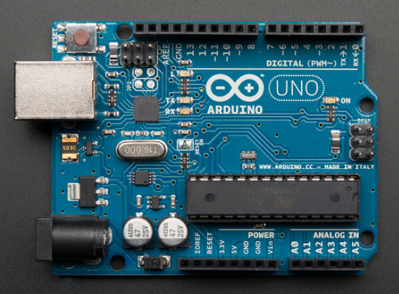
Arduino Uno R3
A popular open-source microcontroller board based on the ATmega328P (8‑bit, 16 MHz).
Features 14 digital I/O (6 PWM), 6 analog inputs, USB and barrel‑jack power, ICSP header, and onboard reset—ideal for beginners and well‑supported by a huge maker community .

Slide 5
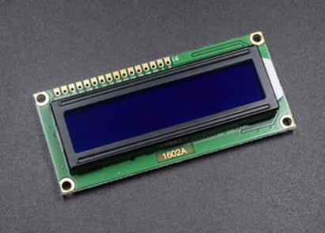
Lcd 16x2 display
Alphanumeric display showing 16 characters on 2 lines, often with HD44780‑compatible controller.
Interfaces via parallel (or I²C using adapter), commonly used to display text, sensor readings, etc.

Slide 6
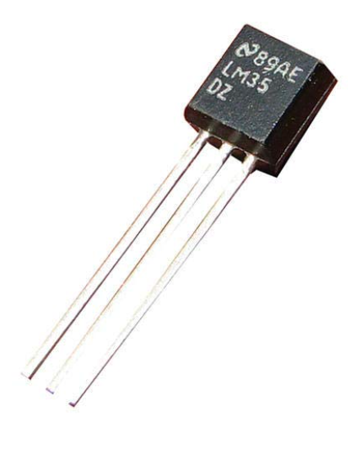
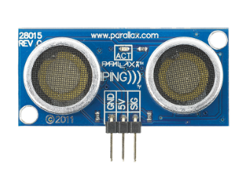
TEMPERATURE SENSOR ((-
Detectors for measuring temperature:
LM35: analog output (10 mV/°C).
ULTRASONIC SENSOR
Measures distance via ultrasonic pulses (transmit/echo).
Suitable for robotics, object detection, ~2 cm‑4 m range.

Slide 7
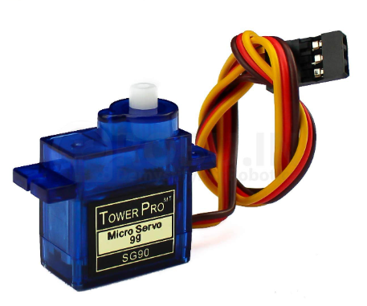
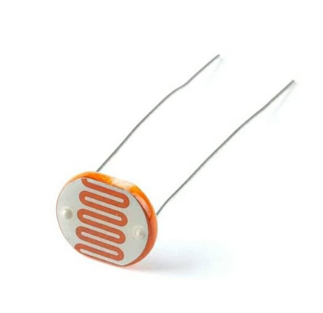
SERVO MOTOR
Small DC motor with internal feedback, controlled by PWM.
Offers precise shaft positioning (usually 0°–180°).
LDR SENSOR
Light Dependent Resistor: resistance decreases as light increases.
Used for simple light-detection circuits.

Slide 8
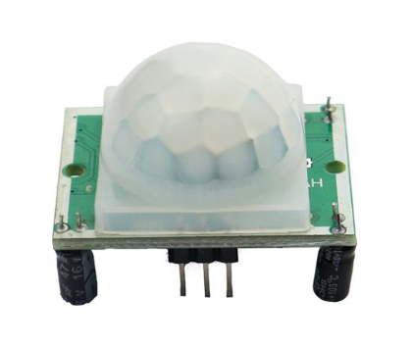
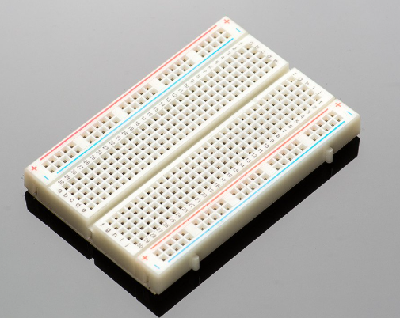
PIR MOTION SENSOR
Passive Infrared sensor that detects motion by sensing IR heat changes.
Common in security and automation.
BREADBOARD AND WIRES
Breadboard: solderless for prototyping circuits.
Jumper wires: male-to-male/female connections for easy wiring.

Slide 9
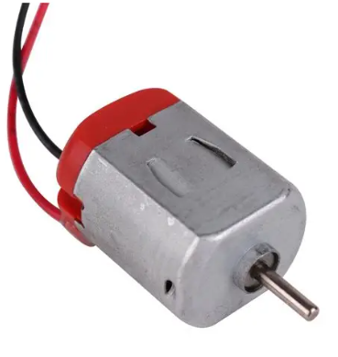
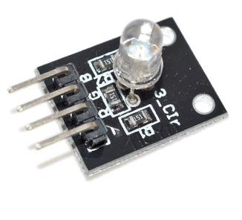
DC MOTOR
Basic motor that spins continuously when powered.
RGB LED
LED with red, green, and blue chips—combine to create various colors.
This was the brief description of the main components which are used.

Slide 10
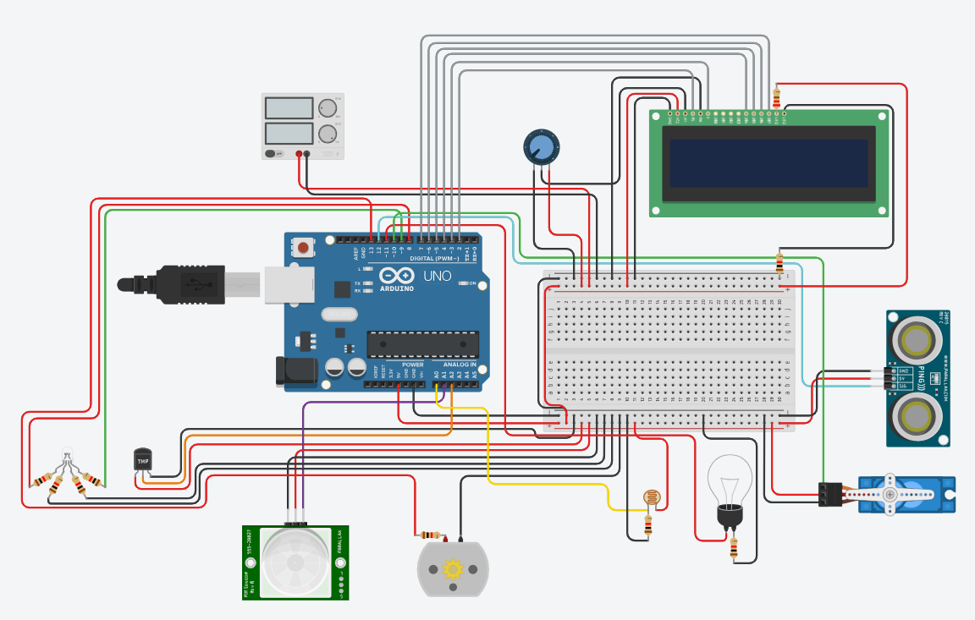
CIRCUIT DIAGRAM

Slide 11
SOURCE CODE
// SMART HOME AUTOMATION
// BY DEVANG CHAUDHARY
#include <Servo.h>
#include <LiquidCrystal.h>
LiquidCrystal lcd(2, 3, 4, 5, 6, 7);
Servo myServo;
int ultrasonicPin = 12;
int LDR_PIN = A0;
int LED_PIN = 11;
int threshold = 500;
int motorpin = 13;
int pirPin = A1;
int tempPin = A2;
int redPin = 8;
int greenPin = 9;
int servoPin = 10;
float temperatureC;
void setup() {
pinMode(LED_PIN, OUTPUT);
pinMode(motorpin, OUTPUT);
pinMode(redPin, OUTPUT);
pinMode(greenPin, OUTPUT);
pinMode(ultrasonicPin, OUTPUT);
pinMode(pirPin, INPUT);
lcd.begin(16, 2);
Serial.begin(9600);
myServo.attach(servoPin);
}
void loop() {
// ===== 1. Ultrasonic Sensor =====
long duration;
float distance;
pinMode(ultrasonicPin, OUTPUT);
digitalWrite(ultrasonicPin, LOW);
delayMicroseconds(2);
digitalWrite(ultrasonicPin, HIGH);
delayMicroseconds(10);
digitalWrite(ultrasonicPin, LOW);

Slide 12
pinMode(ultrasonicPin, INPUT);
duration = pulseIn(ultrasonicPin, HIGH, 30000);
distance = duration * 0.0343 / 2;
Serial.print("Distance: ");
Serial.print(distance);
Serial.println(" cm");
if (distance > 0 && distance <= 50) {
myServo.write(90);
} else {
myServo.write(0);
}
lcd.clear();
lcd.setCursor(0, 0);
lcd.print("Distance:");
lcd.setCursor(0, 1);
lcd.print(distance);
lcd.print(" cm");
delay(1500);
// ===== 2. PIR Sensor =====
int pirState = digitalRead(pirPin);
if (pirState == HIGH) {
digitalWrite(motorpin, HIGH);
Serial.println("Motion Detected");
} else {
digitalWrite(motorpin, LOW);
Serial.println("No Motion");
}
lcd.clear();
lcd.setCursor(0, 0);
lcd.print("PIR Motion:");
lcd.setCursor(0, 1);
lcd.print(pirState == HIGH ? "Motion Detected" : "No Motion");
delay(1500);
// ===== 3. LDR Sensor =====
int lightLevel = analogRead(LDR_PIN);
Serial.print("Light Level: ");
Serial.println(lightLevel);
if (lightLevel < threshold) {
digitalWrite(LED_PIN, HIGH);
} else {
digitalWrite(LED_PIN, LOW);
}
lcd.clear();
lcd.setCursor(0, 0);
lcd.print("Light Level:");
lcd.setCursor(0, 1);
lcd.print(lightLevel < threshold ? "Dark" : "Bright");
delay(1500);
// ===== 4. Temperature Sensor =====
int sensorValue = analogRead(tempPin);
temperatureC = (sensorValue * 5.0 * 100.0) / 1024.0;

Slide 13
Serial.print("Temperature: ");
Serial.print(temperatureC);
Serial.write(176);
Serial.println("C");
if (temperatureC > 40.0) {
digitalWrite(redPin, HIGH);
digitalWrite(greenPin, LOW);
} else {
digitalWrite(redPin, LOW);
digitalWrite(greenPin, HIGH);
}
lcd.clear();
lcd.setCursor(0, 0);
lcd.print("Temp: ");
lcd.print(temperatureC, 1);
lcd.write(176); // degree symbol
lcd.print("C");
lcd.setCursor(0, 1);
lcd.print(temperatureC > 40.0 ? "HOT!" : "Normal");
delay(1500);
}

Slide 14
ARDUINO CODE OVERVIEW
ULTRASONIC SENSOR – It controls the servo motor. If the distance of a object is less than or equal to 50cm, the servo motor rotates at 90° otherwise it remains at its initial position.
TEMPERATURE SENSOR – It is connected to analog pin and it senses the temperature of surroundings. If the value of temperature is more than 40° it turns the RGB led to red otherwise the RGB led remains green.
LDR SENSOR – The LDR sensor senses the intensity of light and turns on the bulb automatically if the value of threshold is less than 500 and turns off the bulb if the value of threshold is more than 500.
PIR MOTION SENSOR – It detects the motion, if an object is detected in the range of PIR motion senor it turns on the DC motor, if no object is detected then the Dc motor will not start.

Slide 15
LCD 16x2 DISPLAY – It displays all the values which are captured by the sensors, value of each sensor is displayed one by one after every 1.5 second as { delay(1500); }.
POTENTIOMETER – It is used for vary voltage.
POWER SUPPLY – It provides the electrical energy required for the board.

Slide 16
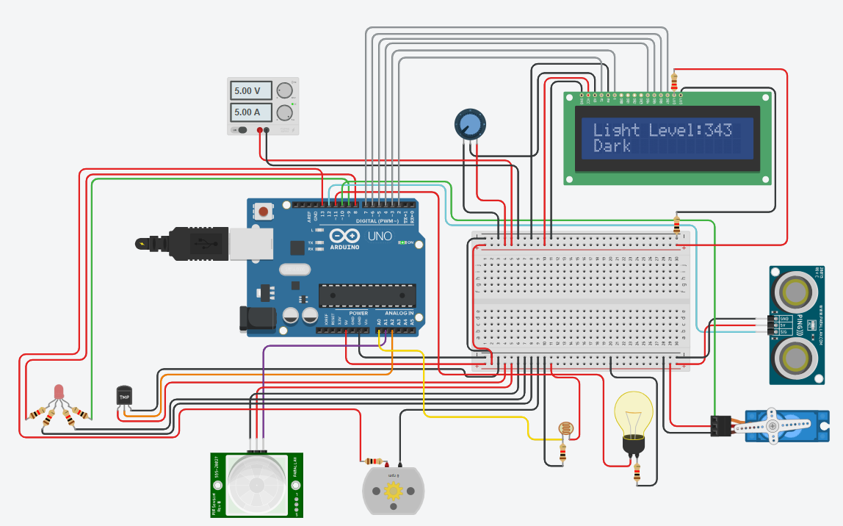
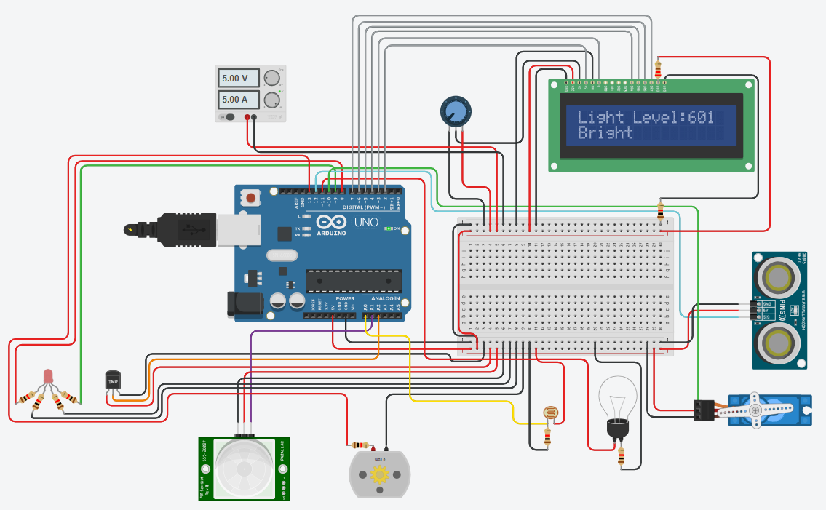
WORKING OF LDR SENSOR IN CIRCUIT
When the threshold level sensed is less than 500
When the threshold level sensed is more than 500

Slide 17
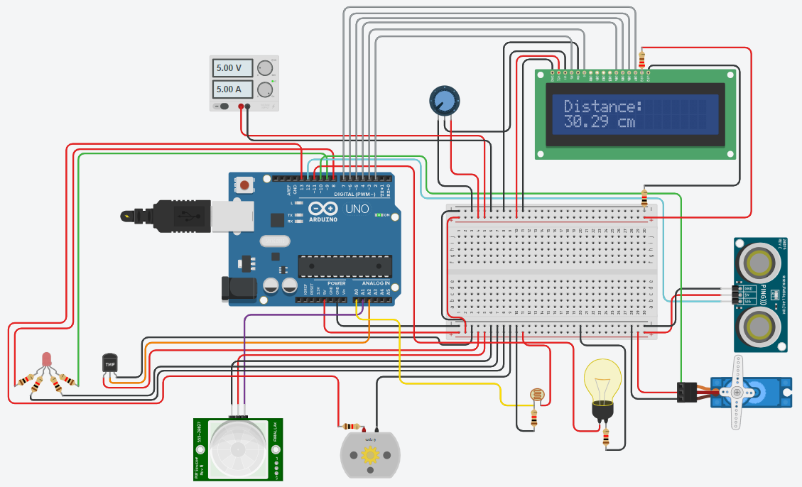
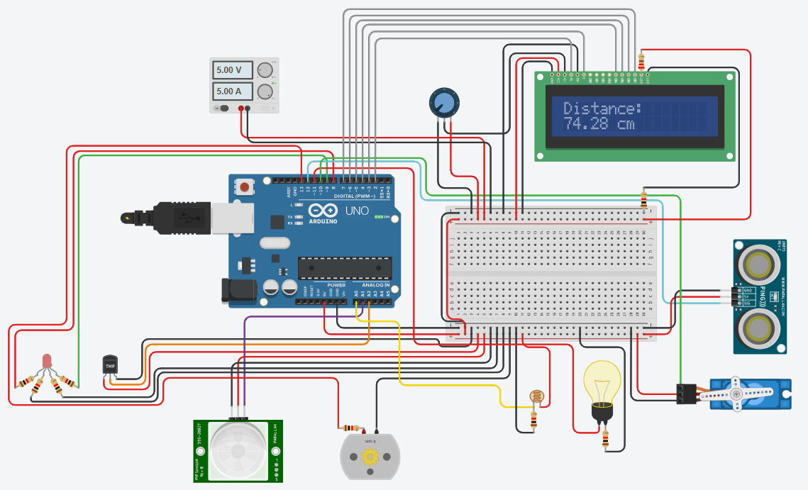
WORKING OF ULTRASONIC SENSOR IN CIRCUIT
When the distance is less than 50cm
When the distance is more than 50cm

Slide 18


WORKING OF TEMPERATURE SENSOR IN CIRCUIT
When the temperature is less than 40°
When the temperature is more than 40°

Slide 19


WORKING OF PIR MOTION SENSOR IN CIRCUIT
When motion is detected
When there is no Motion

Slide 20
CONCLUSION
The Smart Home Automation project effectively illustrates the potential of advanced technology in improving the convenience, security, and energy efficiency of home living.
By combining IoT devices, sensors, the system makes it possible for users to get the values sensed by the sensors in real-time.
This project not only demonstrates the functional uses of automation in everyday life but also provides a foundation for future smart living spaces advancements.

Slide 21
FUTURE SCOPE
We can connect the system to the internet using Wi-Fi (ESP8266/ESP32) or GSM modules.
We can develop an Android/iOS app for controlling appliances, viewing sensor data, and receiving alerts.
We can include sensors for air quality (MQ135), humidity (DHT11/DHT22), or smoke/gas detection (MQ-2).
We can add a feature for sending real-time alerts via SMS, email, or app notifications.

Slide 22
THANK YOU !!

